Slide 1
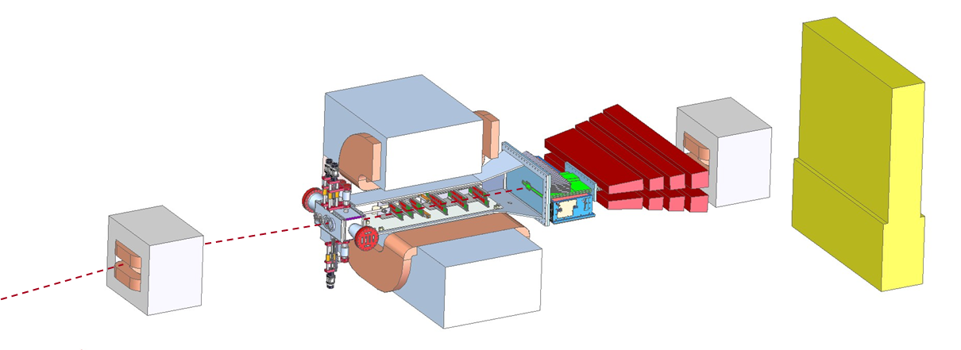
HPS Budget and Schedule
HPS Collaboration Meeting, JLAB
Marco Oriunno, June 4-6, 2013

Slide 2
OUTLINE
1.Project Management Plan (described in the Proposal)
Schedule
Costs
Manpower
2.SLAC Review Jan’13 (Recommendations)
3.DOE review in July (Preparation)

Slide 3
HPS Project Implementation Plan
Scope - Construction, Installation and Commissioning of the HPS experiment at JLAB - Hall B
Organization chart - Parties involved and
Responsibilities sharing within the project
Schedule - Project timeline with milestones toward completion
Budget – Labor and Material required to delivery the scope

Slide 4
HPS Project Org Chart
DOE HEP
Orsay
INFN Ge
JLAB
SLAC
Project Team
Heavy Photon Search Project Manager M. Oriunno Project Scientists J. Jaros S. Stepanyan
HPS Executive Committee
Beamline
Slow Controls
Project Construction Team
SVT
Software
HPS working Groups | Chair (Deputy)
Beamline | K. Moffeit (FX Girod)
SVT | T.Neslon (V.Fedayev)
ECAL | R. Dupre (S.Stepanyan)
Muon | K.Griffioen (Y.Gershtein)
DAQ | S. Boiarinov (P.Hansson)
Trigger | V. Kubarovsky (T.Maruyama)
Slow Control | H. Egiyan (N. Gevorgyan)
Software | M.Haltrop (S.Uemura, O.Moreno)
Analysis | M. Graham (S.Phillips)
Project Management | M. Oriunno (S.Stepanyan, J.Jaros)
SVT DAQ
Analysis
ECal
Trigger/DAQ
Muon

Slide 5
Matrix of Deliverables
Through JLAB
Through SLAC
Through JLAB
 | SLAC | JLAB | ORSAY | INFN | UCSC |  | W&M
Beamline | ● | ●
SVT | ● |  |  |  | ●
SVT DAQ | ● |  |  |  | ●
ECAL |  | ● | ● | ●
TDAQ |  | ● | ●
Slow Control |  | ●
Installation & Commissioning | ● | ● | ● | ● | ●
Project management | ● | ●
MUON |  |  |  |  |  |  | ●

Slide 6
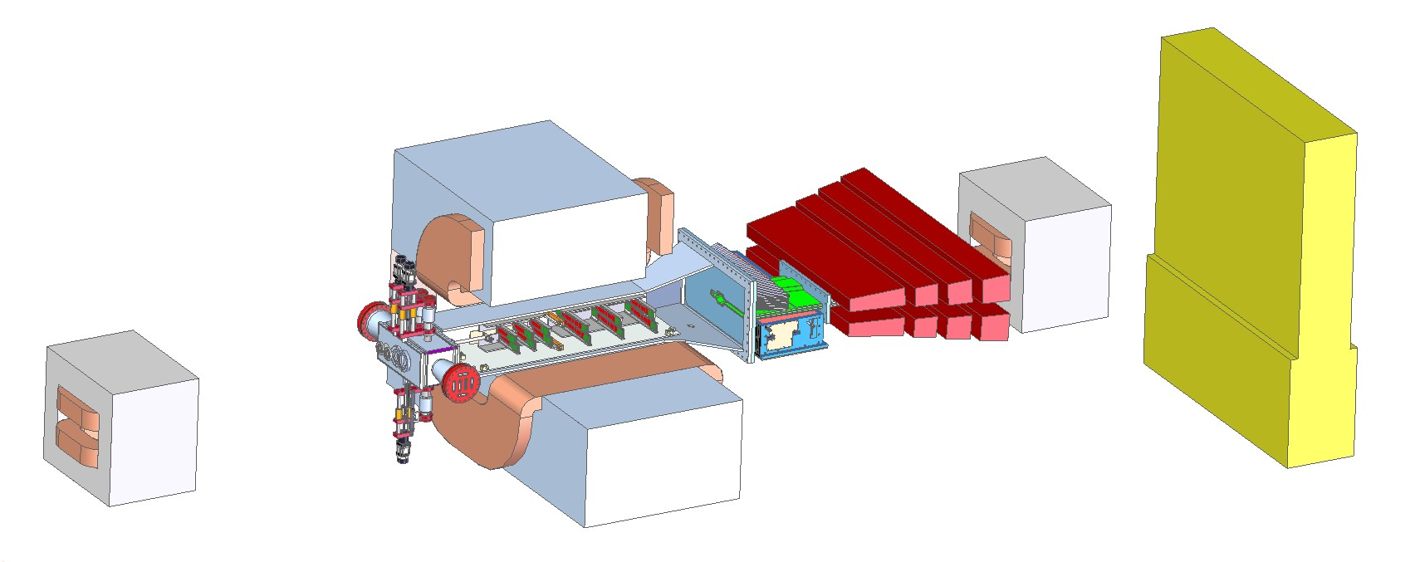
Work Breakdown Structure (WBS)
Material Labor
WBS = Parts (PBS) + Work activities
WBS | NAME
1.1 | Beamline
1.2 | SVT
1.3 | SVT DAQ
1.4 | ECAL
1.5 | TDAQ
1.6 | Slow Control
1.7 | Installation & Commissioning
1.8 | Electron running
1.9 | SLAC Travel and Meetings
1.10 | SLAC Travel for Data Run
1.11 | Project management
1.12 | UCSC
HPS working Groups | Chair (Deputy)
Beamline | K. Moffeit (FX Girod)
SVT | T.Neslon (V.Fedayev)
ECAL | R. Dupre (S.Stepanyan)
DAQ | S. Boiarinov (P.Hansson)
Trigger | V. Kubarovsky (T.Maruyama)
Slow Control | H. Egiyan (N. Gevorgyan)
Software | M.Haltrop (S.Uemura, O.Moreno)
Analysis | M. Graham (S.Phillips)
Project Management | M. Oriunno (S.Stepanyan, J.Jaros)

Slide 7
HPS Project Execution Plan
Scope Management Work Breakdown Structure
Requirements Management Scientific Requirements Flow Down
Schedule Management Tracking of Schedule and Milestones
Financial Management Tracking Cost book and Expenditure
Quality Management Consistency with Requirements (Reviews) Resource Management Manpower Leveling
Risk Management Risk Assessment and Mitigation
Procurement Management Purchase of Items > $15k
Monthly meeting PM (Chair)+ PIs + Construction Team

Slide 8
Schedule Drivers
Early Physics Window Opportunity at CEBAF in October ‘14
Today
Oct.’14
May.’15
Sep.’16
HPS Construction
Data Runs
Analysis
FY13
FY14
FY15
FY16
Construction + Testing
# 19 months
Operations
# 6 months
Analysis

Slide 9
Schedule - Beamline
Milestones & Reviews
Beamline Design review Dec.’13
Installation review Aug.’14
Beamline Installed Sep.’14
Work at JLAB starts ~ April 2014
Design
Construction
Mar.’13
Dec.’13
Sep.’14

Slide 10
Schedule – SVT Mechanics
Milestones&Reviews
SVT returns from Jlab Feb.’13
SVT Engineering Design Review Jul.’13
Layer 1-3 Ready Mar.’14
Layer 4-6 Ready Apr.’14
SVT Ready for Shipment Jun.’14
SVT Ready For Installation Aug.’14
Construction
Testing
Mar.’13
Apr.’14
Aug.’14

Slide 11
Schedule – SVT DAQ
Milestones&Reviews
FE board tested w/ hybrid 28-Aug-13
Flange DAQ tested 10-Jan-14
DAQ full system Test 2-Jun-14
Single hybrid qualication 28-Aug-13
Construction
Testing
Mar.’13
Apr.’14
Aug.’14

Slide 12
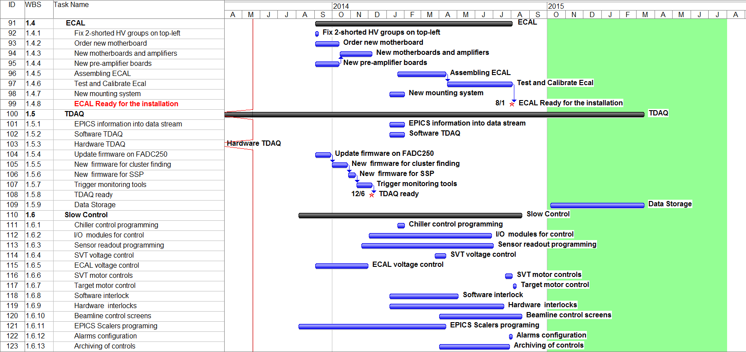
Schedule – ECAL+ TDAQ + Slow Control
Milestones & Reviews
TDAQ ready Dec.6, 2013
ECAL Ready for installation Aug.1, 2014

Slide 13
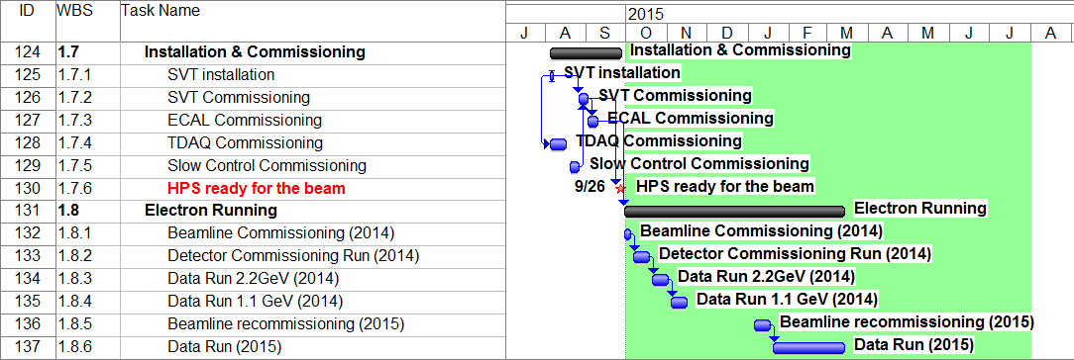
Schedule – Installation, Commissioning and Data Runs
Installation in Hall-B happens at the end of August~ 2 weeks
Beamline Commissioning ~1 week
Detector Commissioning ~ 1 week
Test Run Installation was 1.5 day (16 hours no stop!) with 1 week preparation in the clean room. The same crews will do the installation in 2014.

Slide 14
Schedule – Milestones toward the Data Runs
WBS | Name | Date
1.1 | Beamline
1.1.2 | Beamline Review | 20-Dec-13
1.1.12 | Installation review | 18-Aug-14
1.1.14 | Beamline Installed | 26-Sep-14
1.2 | SVT
1.2.1 | SVT Design Review | 20-Aug-13
1.2.3 | Layer 1-3 Ready | 17-Feb-14
1.2.5 | Layer 4-6 Ready | 21-Feb-14
1.2.14 | SVT tested and ready for shipment | 9-Jun-14
1.2.16 | SVT Ready For Installation | 15-Aug-14
1.3 | SVT DAQ
1.3.3 | FE Board Tested w/ hybrid | 28-Aug-13
1.3.5 | Flange DAQ Tested | 10-Jan-14
1.3.7 | DAQ Full system Test | 2-Jun-14
1.3.8 | Hybrid | 23-Apr-13
1.3.8.8 | Single Hybrid qualification | 28-Aug-13
1.3.10 | Flex Cable w/ hybrid&FE board | 10-Jan-14
1.4 | ECAL
1.4.8 | ECAL Ready for the installation | 1-Aug-14
1.5 | TDAQ
1.5.8 | TDAQ ready | 6-Dec-13
1.7 | Installation & Commissioning
1.7.6 | HPS ready for the beam | 26-Sep-14

Slide 15
Costs – Tools and Methodology
Schedule and Costs are simultaneously managed with MS Project
Tasks are tracked down to WBS Level 3 Min.
Labor is added in hours by skills. M&S as number of required units
Only Engineering Labor + Overhead 53% (Material 7.65%)
Contingency :
10% Catalogue Items
20-25% Similar to previous design
30-50% New design

Slide 16
HPS Total Costs = $ 2,971,783
 | Labor | Material | Total
SLAC | $ 1,399,641 | $ 1,073,558 | $ 2,473,200
JLAB | $ 361,503 | $ 137,080 | $ 498,583
HPS Total | $ 1,761,144 | $ 1,210,638 | $ 2,971,783

Slide 17
Costs Breakdown : Capital Equipments vs. Operations
Task Name | Labor | Material | Total | Spares | Proto. | Operations | Infra | Capital Equipments
HPS | $ 1,761 | $ 1,211 | $ 2,972 | $ 78 | $ 21 | $ 928 | $ 248 | $ 1,796
Beamline | $ 91 | $ 131 | $ 223 | $ - | $ - | $ - | $ 6 | $ 217
SVT | $ 452 | $ 204 | $ 656 | $ 8 | $ 10 | $ 75 | $ 43 | $ 539
SVT DAQ | $ 431 | $ 352 | $ 782 | $ 70 | $ 11 | $ 80 | $ 162 | $ 540
ECAL | $ 36 | $ 12 | $ 48 | $ - | $ - | $ - | $ - | $ 48
TDAQ | $ 151 | $ 10 | $ 161 | $ - | $ - | $ - | $ 10 | $ 151
Slow Control | $ 94 | $ 39 | $ 134 | $ - | $ - | $ - | $ 28 | $ 106
Installation & Commissioning | $ 58 | $ - | $ 58 | $ - | $ - | $ 55 | $ - | $ 3
Electron Running | $ - | $ - | $ - | $ - | $ - | $ - | $ - | $ -
SLAC Travel Meetings | $ 125 | $ - | $ 125 | $ - | $ - | $ 125 | $ - | $ -
SLAC Travel for Commissioning and Running | $ 156 | $ - | $ 156 | $ - | $ - | $ 130 | $ - | $ 26
Project management | $ 167 | $ - | $ 167 | $ - | $ - | $ - | $ - | $ 167
UCSC Funds | $ - | $ 463 | $ 463 | $ - | $ - | $ 463 | $ - | $ -
< $2M
Capital Equipment (CE) | Labor and Material costs of the parts constituting the experimental apparatus, which is required to perform the physics. They do not include spares and prototyping
Infrastructures (INFRA) | Labor and Materials cost for general purpose infrastructures required by the apparatus, which can be reused for other experiments, e.g, Chiller, Power Supplies, PLC
Operation (OP) | Labor and Material Costs incurred for the commissioning and the operation of the experimental set up, as well as Spare Parts, Prototype and R&D activities.

Slide 18
Spending Profile
Keep alive funds FY13
$414k
FWP
FY14-FY15-FY16
SVT Review

Slide 19
Manpower – FTE Labor Breakdown
 | FY13 | FY14 | FY15 | FY16
ME | 0.19 | 0.64 | 0.14 | 0.02
MD | 0.09 | 0.30 | 0.00 | 0.00
MT | 0.08 | 0.49 | 0.00 | 0.00
EE | 0.58 | 0.76 | 0.05 | 0.02
ET | 0.01 | 0.04 | 0.00 | 0.00
Labor profile SLAC
 | FY13 | FY14 | FY15 | FY16
ME | 0.00 | 0.03 | 0 | 0
MD | 0.05 | 0.06 | 0 | 0
MT | 0.00 | 0.14 | 0 | 0
EE | 0.12 | 1.19 | 0 | 0
ET | 0.02 | 0.07 | 0 | 0
Labor profile JLAB
The Tables summarize only the engineering labor accounted as expenditures
The do not include the labor provided by physicists or the engineering provided by Orsay and INFN-GE

Slide 20
SLAC Director’s Review Jan.11, 2013
Topics | # | Comments
Can the team adequately justify the cost? | 2.b | There is no discussion of the costs of the HPS test run. Perhaps a discussion of the actual costs versus the estimate would provide some insight. It may also give the reviewer some confidence that there was some learning from the HPS test that is being applied to assure that the budgets are adequate.
Is there a management team in place, have resources been identified, and has risk mitigation been adequately addressed | 4.e | There were no design alternatives identified that would allow for de-scoping the experiment if cost and schedule problems arise
 | 4.f | The most significant risks to the project should be identified and a plan for mitigating these risks developed identifying design alternatives, de-scoping, increased contingency, etc.
Concluding Comments | 5.c | The experiment must avoid the cost over-runs and rush for completion that occurred during the test run.
 | 5.d | The schedule, including the spending and labor profiles, appears to be very aggressive, and the timing of the commissioning run may not allow for adequate preparation and testing.
 | 5.e | The risk to the HPS science program from not having sufficient cost and schedule contingency should be carefully considered.

Slide 21
DOE Review July 11, 2013: HPS Charge Letter
The quality and the impact of the research by the HPS collaboration in the recent past
The scientific significance, merit and feasibility of the proposal research;
The competence and future premise of the HPS collaboration for carrying out the proposed research;
The adequacy of the resources for carrying out the proposed research and cost-effectiveness of the research investment;
The quality of the support and the infrastructure provided by the participating laboratories.
More in detail :
Did the HPS collaboration successfully demonstrates the technical feasibility of its detector design in its 2012 test run at JLAB ?
Has the HPS collaboration developed technical design and construction and commissioning plans for its components that are consistent with the readiness to begin taking data in FY15 in the low energy beam in Hall B at JLAB ?
Has the HPS collaboration identified and costed for the appropriate manpower and the other resources consistent with readiness to take data in FY15 ?
Has the HPS collaboration presented estimates of cost and schedule that are consistent with readiness to take data in FY15
Has the HPS collaboration developed a credible staging plan installation of detector components that will allow for data taking in FY15 ?

